Slide 1
INDONESIA MINISTRY OF NATIONAL DEVELOPMENT PLANNING
CIVIL REGISTRATION AND VITAL STATISTICS (CRVS)
IN INDONESIA
Utin Kiswanti
Deputy Director for Population Mobility
Technical Seminar on Legal Framework for Civil Registration, Vital Statistics and
Identity Management Systems
Manila, 17-19 July 2017

Slide 2
Challenges in CRVS System

Slide 3
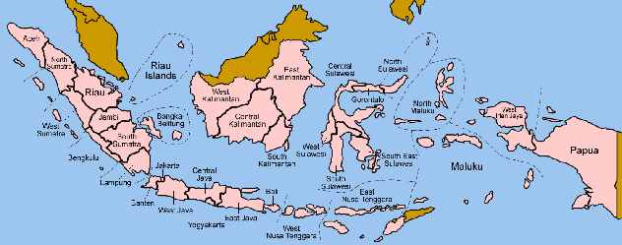
16th largest by landmass
80% areas are prone to natural disaster (Disaster Index, 2011)
4th largest by population
250 million people | 82.5 million children (2010 census) | 360 ethnic groups | 250 local languages
Lower-middle by income status, Gini Ratio rising
96 million people live in poverty | 23 million are children (PPLS, 2011)
New democracy, ongoing decentralization
34 provinces, 500+ districts, 77126 villages | 17504 islands

Slide 4






The CRVS system is far from universal, continuous, and compulsory
Birth registration. 34% children unregistered or 27 million children (SUSENAS, 2016) |
62% from the poorest families
66% living in rural areas
Birth registration situation often time reflects similar or lesser state in other vital events registration
Source: National Social Economic Survey (SUSENAS), 2016 [Processed Bappenas]

Slide 5
55% marriages amongst the poorest unregistered, 75% of their children didn’t have a BC (AIPJ-PUSKAPA-PEKKA, 2013)
Marriage registration process are split into two institutions, MoRA for Islam marriage and MoHA for all non-Islam marriage. All marriage registration require a letter from official religious marriage.
2% divorcees had a divorce certificate (KOMPAK-PUSKAPA, 2015). Divorce process are split into two institutions, Religious Court for Islam marriage and State Court for all non-Islam marriage.

Slide 6
Death registration. No official coverage data (“10.27%”, Ministry of Home Affairs: SIAK 2016) | 84% deaths took place at home, 2% of them registered the event (KOMPAK-PUSKAPA, 2015)

Slide 7
Structural barriers are more dominant than lack of awareness
Prohibitive cost
BC had not yet been issued
Do not understand the process
Far
distance
Do not feel BC is necessary
34%
20%
8%
8%
7%
Don’t bother
Do not know that birth has to be registered
6%
1%
Source: National Social Economic Survey (SUSENAS), 2016 [Processed Bappenas]

Slide 8
Passive-passive conundrum in low resource setting
Services that tend to be passive, unreachable and complicated
Passive people report important events
Weak coordination and fragmented CRVS policies
Incomplete population data to produce accurate vital statistics so that demand and utilization are low

Slide 9





People with special condition face more challenges; unreached and unidentified
5X
Less likely that children with parents with disability will have a birth certificate
2X
Children without birth certificate live in rural area compared to urban area
Other groups:
Indigenous community
Local belief community
Nomadic tribe
Children outside family care,
Children from mixed marriage between Indonesians and undocumented migrants, asylum seekers or refugees.

Slide 10
Opportunities

Slide 11
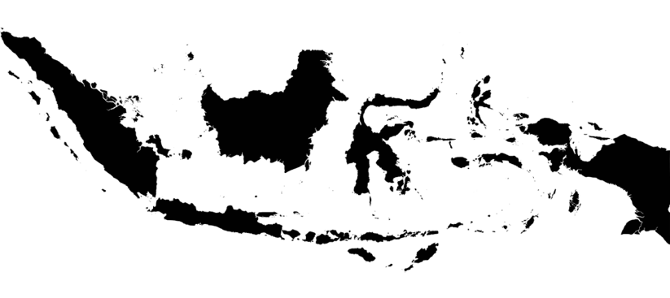
POLITICAL WILL
“
The state must be present to protect the whole nation and to provide a sense of security to all citizens
- PRESIDEN JOKO WIDODO -
The State attends as the Government continuously records the life events of each individual continuously, gives everyone legal identity without discrimination,
and utilizes the data obtained to provide quality and inclusive public services.

Slide 12
POLICY FRAMEWORK
GOI in RPJMN* 2015-2019 included legal identity as one of the main poverty reduction strategies, alongside the provision of health, education, social protection and basic infrastructure. Taking this national strategy into programs and more importantly into practice is more critical than ever
*RPJMN: National Medium Term Development Plan (2015-2019)
Notes:
By % it means % points!!

Slide 13
GoI Target in RPJMN 2015-2019
BY 2019
NOW WE ARE AT
(Susenas 2016)
85%
0-17 years old have
birth certificates
66%
0-17 years old have
birth certificates
IN 4 YEARS WE NEED TO REACH
19% *INCREASE (over all) & 27%* INCREASE (for the poorest)
77%
0-17 years old
in the poorest 40%
have birth certificates
61%
0-17 years old
in the poorest 40%
have birth certificates

Slide 14
EXISTING LEGAL FRAMEWORK
MAIN LAW
SUPPORTING LAWS
IMPLEMENTING REGULATIONS
Law No. 23 of 2006 and Law No. 24 of 2013 on Population Administration
Law on Public Service
Law on Legal Aid
Law on Local Government
Law on Village
Law on Disability Rights
Regulation to waive marriage certificate for BC
Regulation to waive fee during integrated mobile services
SOP on integrated mobile service
Decree on acceleration of birth & death registration, ID card
Various local bylaws
Draft SOPs on 25 civil registration events and 9 population registration events

Slide 15
EXISTING LEGAL FRAMEWORK
VITAL STATISTICS
COLLECTION, SHARING, AND USE
IDENTITY MANAGEMENT SYSTEM
COLLABORATION AND COORDINATION
Joint decree on Death Registration and COD recording between Ministry of Health and MoHA
Ministerial decree on Primary Health Care Information System
Government Regulation on National Health System
Joint decree between MoHA and Ministry of Education on Unique ID Number utilization
Ministerial decree on Manual, Review, Development and Management Process of SIAK
Joint regulation on Integrated Mobile Services between Supreme Court, MoHA, and Ministry of Religious Affairs
Draft of Presidential Decree on National Strategies on CRVS 2017-2024

Slide 16
PARADIGM SHIFT IN THE NEW LAW
Law 24/2013 on Revision of the Population Administration Law
Legal identity documents now free of charge
The government is obligated to do outreaching
Centralized planning and budgeting but localized service delivery
Make sure local government does not apply fines, unsolicited collection of fees
Proper allocation of resources for more mobile and integrated services
Coordination on demand-based proposal for funding and adequate allocation of budget
Notes:
KEEP

Slide 17
NATIONAL STRATEGIES ON CRVS [DRAFT]: MAIN OBJECTIVES
1
2
3
CONTINOUS, UNIVERSAL, AND INCLUSIVE CIVIL AND POPULATION REGISTRATION
ALL CITIZENS AND POPULATION HAVE COMPLETE AND RELEVANT LEGAL IDENTITY DOCUMENTS
AVAILABILITY OF QUALITY, ACCURATE, RELEVANT, AND COMPREHENSIVE VITAL STATISTICS

Slide 18





COMPREHENSIVE NATIONAL STRATEGIES [DRAFT]:
FIVE POLICY DIRECTIONS
COMMUNITY OUTREACH ON CIVIL REGISTRATION AND POPULATION REGISTRY SERVICES
INCREASING COMMUNITY AWARENESS AND INITIATIVES TO REGISTER THEIR VITAL EVENTS
STRENGHTEN COORDINATION AND COLLABORATION BETWEEN STAKEHOLDERS
INCREASING AVAILABILITY AND QUALITY OF ACCURATE VITAL STATISTIC FOT MULTI SECTORS DEVELOPMENT
ACCELERATION ON THE OWNERSHIP OF CIVIL REGISTRATION AND POPULATION REGISTRY DOCUMENT FOR SPECIAL GROUPS

Slide 19
Policies Related to Population and Civil Registration
in RPJMN 2015-2019
Increase availability and quality of Data, and population information
Inequality of access in the outreach of basic services, including the right to identity.
Strengthening integrated national demographic system.
Improved quality of life and optimal growth of children.
BC guarantee children access to various basic services, social services, legal services, and reduce the risk of children experiencing neglect, exploitation, and trafficking
Strengthen research and development management and health information systems, through:
Strengthen research and development management to support evidence based health development policies, including death and testimony data and development of responsiveness measures of the health system.
Development and implementation of data collection systems for monitoring of health development indicators.

Slide 20
NEXT STEPS
Preparation of the Presidential Regulation as the regulatory framework of the CRVS National Strategy
High level ministerial and parliament discussion of the draft
Presidential endorsement for the National Strategies and working committee (echelon 1)
Follow-up implementation of CRVS National Strategy.
Discussion around implementing regulation on the latest Law on Population and Civil Registration 2013 between Bappenas, MoHA, and Office of Presidential Staff
Drafting of SOPs for 25 civil status registration and 9 population registration events
Thank you

